Slide 1
Functional equasions

Slide 2
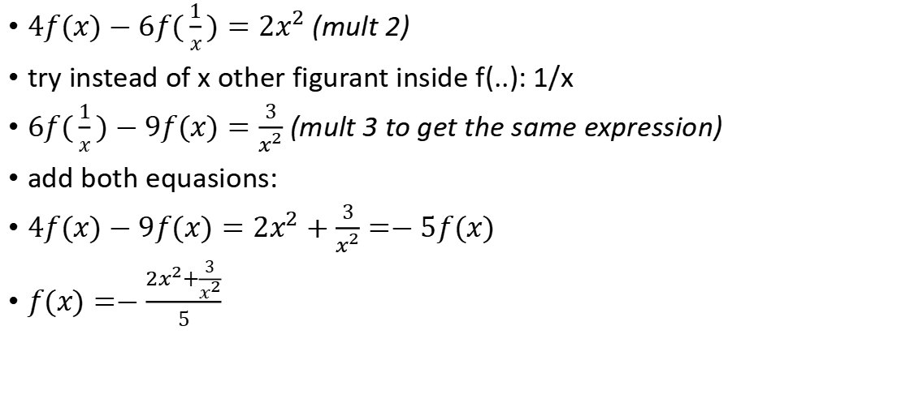

$$2f(x)−3f(\frac{1}{x})=x^{2}$$
$4f(x)−6f(\frac{1}{x})={2x}^{2}$ (mult 2)
try instead of x other figurant inside f(..): 1/x
$6f(\frac{1}{x})−9f(x)=\frac{3}{x^{2}}$ (mult 3 to get the same expression)
add both equasions:
$4f(x)−9f(x)={2x}^{2}+\frac{3}{x^{2}}=−5f(x)$
$f(x)=−\frac{{2x}^{2}+\frac{3}{x^{2}}}{5}$

Slide 3


$$f(\frac{\sqrt{x^{2}+1}−x}{x})=x^{2}$$
$\frac{\sqrt{x^{2}+1}−x}{x}=t$
$\sqrt{x^{2}+1}=x(t+1)$
$x^{2}+1=x^{2}{(t+1)}^{2}$
$x^{2}{(t+1)}^{2}−1)=1$
$x^{2}=\frac{1}{{(t+1)}^{2}−1}$
$f(t)=\frac{1}{{(t+1)}^{2}−1}$

Slide 4
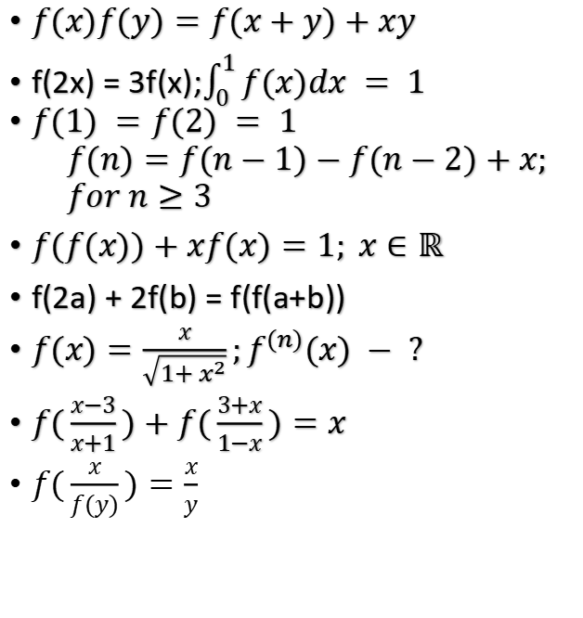
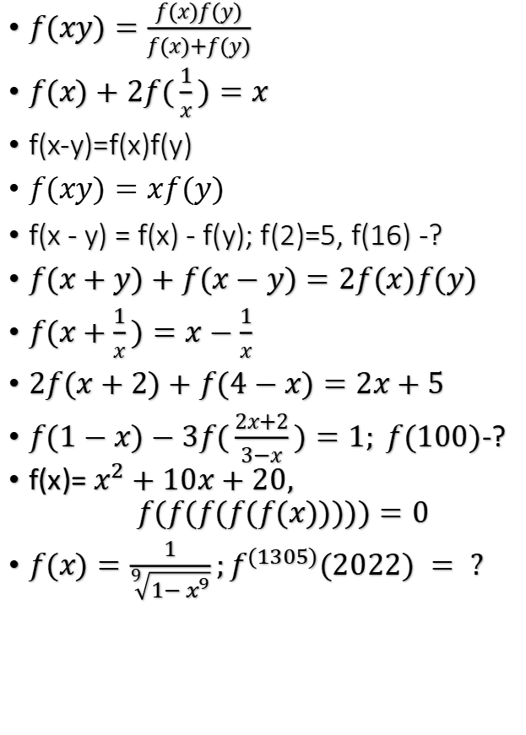
List:
$f(xy)=\frac{f(x)f(y)}{f(x)+f(y)}$
$f(x)+2f(\frac{1}{x})=x$
f(x-y)=f(x)f(y)
$f(xy)=xf(y)$
f(x - y) = f(x) - f(y); f(2)=5, f(16) -?
$f(x+y)+f(x−y)=2f(x)f(y)$
$f(x+\frac{1}{x})=x−\frac{1}{x}$
$2f(x+2)+f(4−x)=2x+5$
$f(1−x)−3f(\frac{2x+2}{3−x})=1; f(100)$-?
f(x)= $x^{2}+10x+20,$ $$f(f(f(f(f(x)))))=0$$
$f(x)=\frac{1}{\sqrt[9]{1−x^{9}}};f^{(1305)}(2022) = ?$
$f(x)f(y)=f(x+y)+xy$
f(2x) = 3f(x);$\int_{0}^{1}{f(x)dx = 1}$
$f(1) =f(2) = 1$ $$f(n)=f(n−1)−f(n−2)+x; \\ for n≥3$$
$f(f(x))+xf(x)=1; x∈ℝ$
f(2a) + 2f(b) = f(f(a+b))
$f(x)=\frac{x}{\sqrt{1+x^{2}}};f^{(n)}(x) − ?$
$f(\frac{x−3}{x+1})+f(\frac{3+x}{1−x})=x$
$f(\frac{x}{f(y)})=\frac{x}{y}$

Slide 5

Basicks
: if
f(x+y ) = f(x) + f(y) the solution is only f(x) = kx
$f(xy)=f(x)+f(y)$ the solution is only f(x) $=klnx$

Slide 6


$$f(xy)=\frac{f(x)f(y)}{f(x)+f(y)}$$
$\frac{1}{f(xy)}=\frac{1}{f(x)}+\frac{1}{f(y)}$
$g(xy)=g(x)+g(y)$
it can be ONLY $g(x)=klnx$ so
$f(x)=\frac{k_{2}}{lnx}$

Slide 7


$$f(x)+2f(\frac{1}{x})=x$$
$f(x)+2f(\frac{1}{x})=x$
$try \frac{1}{x}: f(\frac{1}{x})+2f(x)=\frac{1}{x}$
$2f(\frac{1}{x})=x−f(x)$
2$f(\frac{1}{x})+4f(x)=x−f(x)+4f(x)=\frac{2}{x}$
$3f(x)=\frac{2}{x}−x$
$f(x)=\frac{2}{3x}−\frac{x}{3}$

Slide 8

f(x-y)=f(x)f(y)
$f(x−0)=f(x)f(0) => f(0)=1 or f(x)=0$
$f(x−x)=f(0)=1=f^{2}(x)=>f(x)=±1$
Not all functions, gained in this way fit:
$−1 ≠−1∗−1,$
so solutions are $f(x)=0 or 1$

Slide 9

$$f(xy)=xf(y)$$
$f(xy)=xf(y)=yf(x)$
$f(x0)=xf(0)=0f(x))=0$
$f(x1)=xf(1)=xc$ -> f(1) can be used as a constant

Slide 10
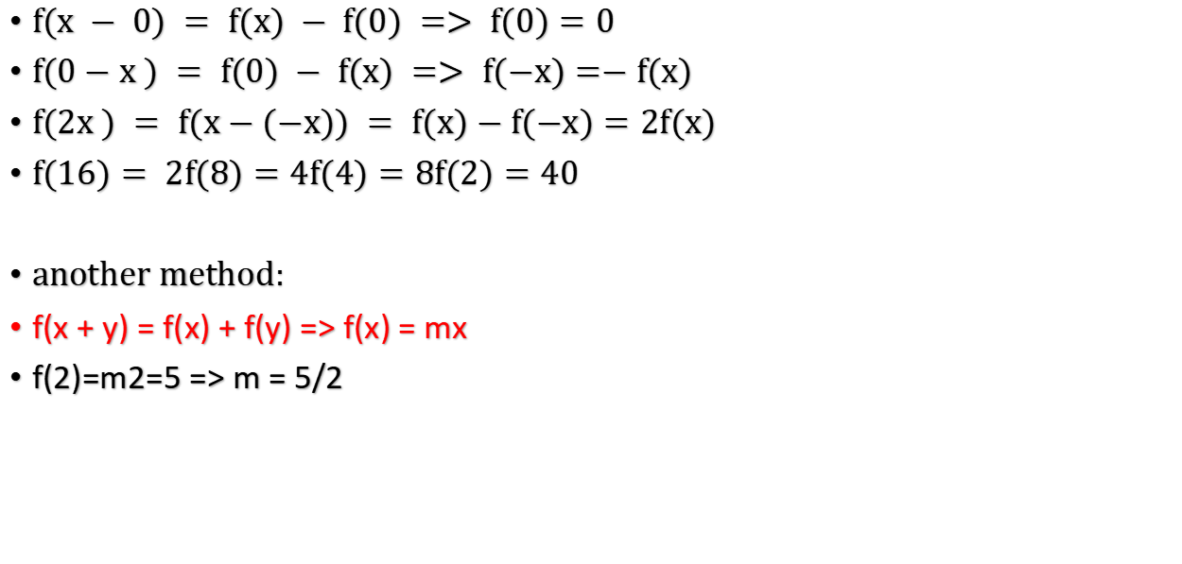
f(x - y) = f(x) - f(y); f(2)=5, f(16) -?
$f(x − 0) = f(x) − f(0) => f(0)=0$
$f(0−x ) = f(0) − f(x) => f(−x)=−f(x)$
$f(2x ) = f(x−(−x)) = f(x)−f(−x)=2f(x)$
$f(16)= 2f(8)=4f(4)=8f(2)=40$
another method:
f(x + y) = f(x) + f(y) => f(x) = mx
f(2)=m2=5 => m = 5/2

Slide 11
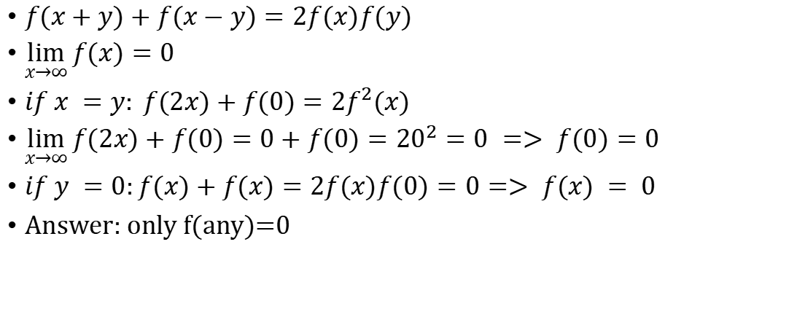
$$f(x+y)+f(x−y)=2f(x)f(y)$$

Slide 12
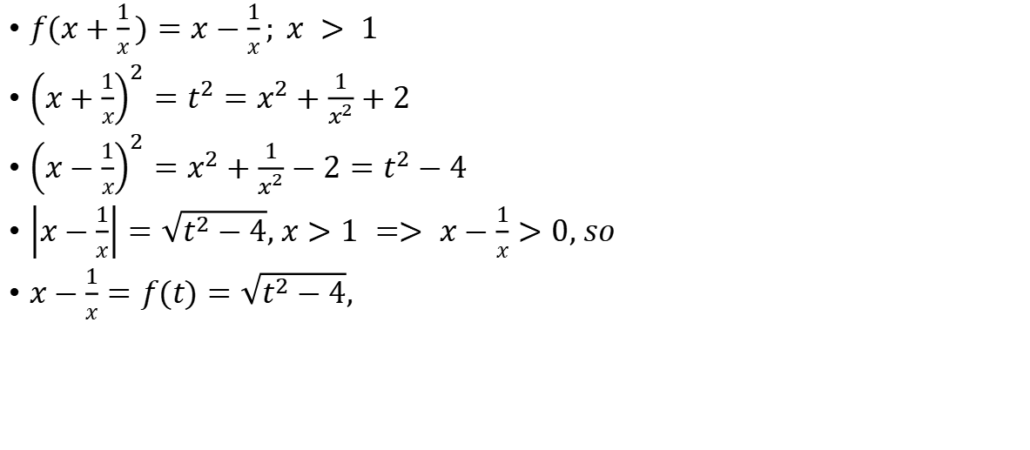

$$f(x+\frac{1}{x})=x−\frac{1}{x}$$

Slide 13
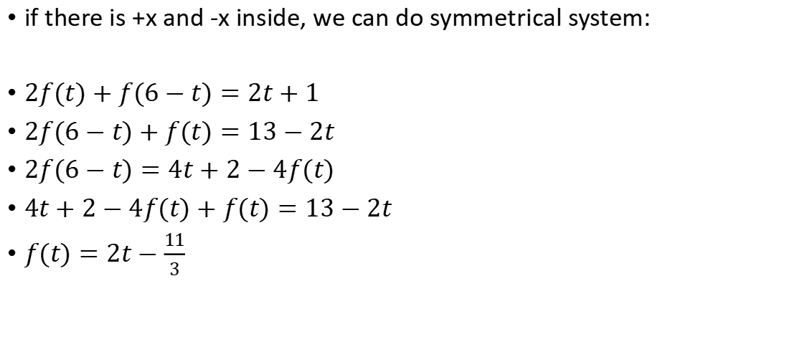

$$2f(x+2)+f(4−x)=2x+5$$
if there is +x and -x inside, we can do symmetrical system:
$2f(t)+f(6−t)=2t+1$
$2f(6−t)+f(t)=13−2t$
$2f(6−t)=4t+2−4f(t)$
$4t+2−4f(t)+f(t)=13−2t$
$f(t)=2t−\frac{11}{3}$

Slide 14
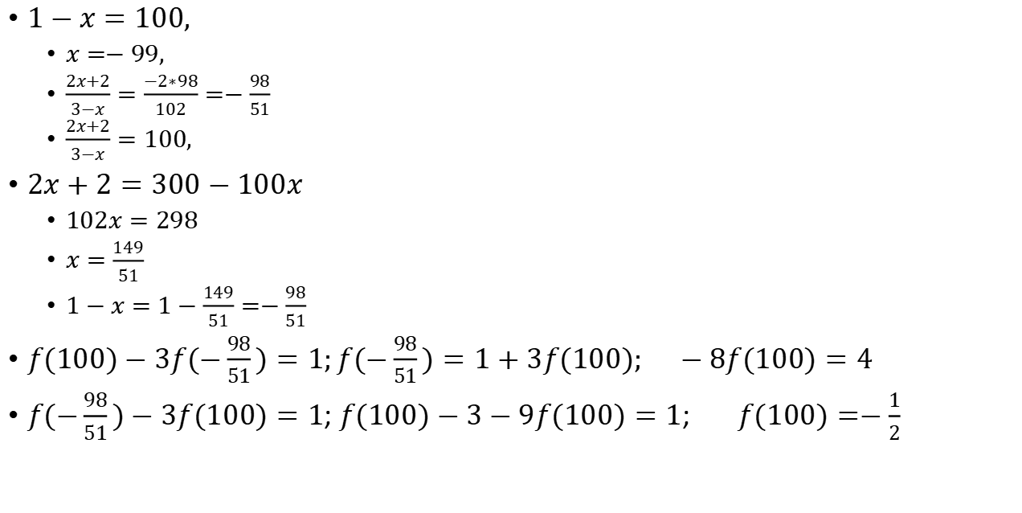
$f(1−x)−3f(\frac{2x+2}{3−x})=1; f(100)$-?
$1−x=100,$
$x=−99,$
$\frac{2x+2}{3−x}=\frac{−2∗98}{102}=−\frac{98}{51}$
$\frac{2x+2}{3−x}=100,$
$2x+2=300−100x$
$102x=298$
$x=\frac{149}{51}$
$1−x=1−\frac{149}{51}=−\frac{98}{51}$
$f(100)−3f(−\frac{98}{51})=1;f(−\frac{98}{51})=1+3f(100); −8f(100)=4$
$f(−\frac{98}{51})−3f(100)=1$; $f(100)−3−9f(100)=1$; $f(100)=−\frac{1}{2}$

Slide 15
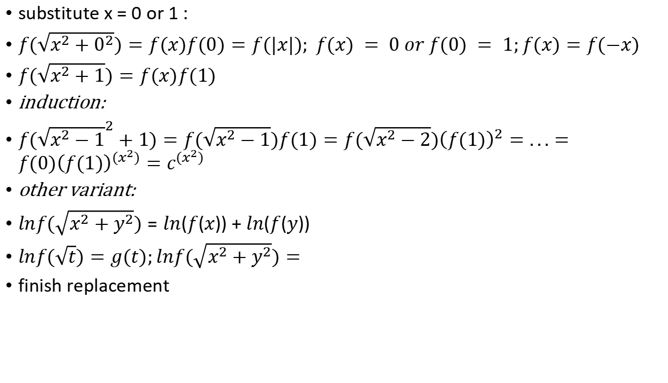
$$f(\sqrt{x^{2}+y^{2}})=f(x)f(y)$$
substitute x = 0 or 1 :
$f(\sqrt{x^{2}+0^{2}})=f(x)f(0)=f(|x|); f(x) = 0 or f(0) = 1;f(x)=f(−x)$
$f(\sqrt{x^{2}+1})=f(x)f(1)$
induction:
$f({\sqrt{x^{2}−1}}^{2}+1)=f(\sqrt{x^{2}−1})f(1)=f(\sqrt{x^{2}−2}){\left(f(1)\right)}^{2}=...=f(0){\left(f(1)\right)}^{(x^{2})}=c^{(x^{2})}$
other variant:
$lnf(\sqrt{x^{2}+y^{2}})=ln(f(x))+ln(f(y))$
$lnf(\sqrt{t})=g(t);lnf(\sqrt{x^{2}+y^{2}})=$
finish replacement

Slide 16

f(x)= $x^{2}+10x+20, f(f(f(f(f(x)))))=0$
$f(x)={\left(x+5\right)}^{2}−5$
$f(f(x))={\left({\left(x+5\right)}^{2}−5+5\right)}^{2}−5={\left(x+5\right)}^{4}−5$
$f^{(3)}(x)=|the same way| = {\left(x+5\right)}^{8}−5$
...
$f^{(5)}(x)={\left(x+5\right)}^{32}−5=0$
$x+5=\sqrt[32]{5}$
$x=\sqrt[32]{5}−5$

Slide 17
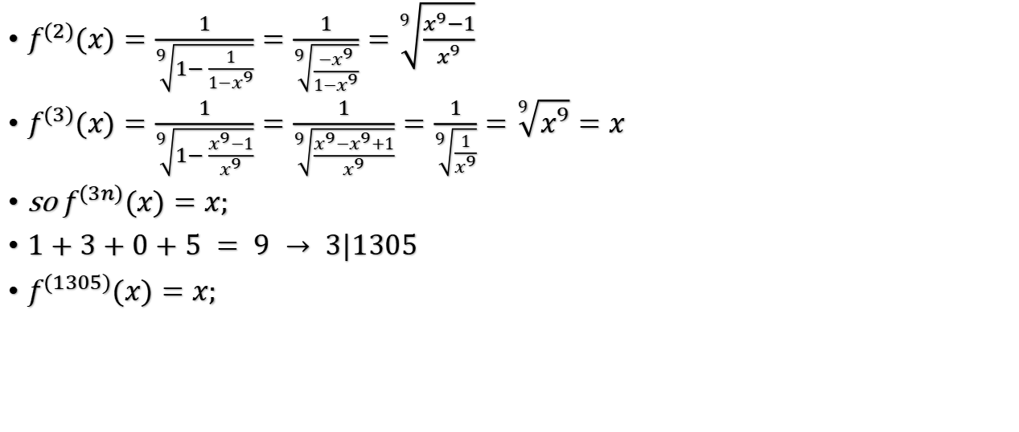

$$f(x)=\frac{1}{\sqrt[9]{1−x^{9}}};f^{(1305)}(2022) = ?$$
$f^{(2)}(x)=\frac{1}{\sqrt[9]{1−\frac{1}{1−x^{9}}}}=\frac{1}{\sqrt[9]{\frac{−x^{9}}{1−x^{9}}}}=\sqrt[9]{\frac{x^{9}−1}{x^{9}}}$
$f^{(3)}(x)=\frac{1}{\sqrt[9]{1−\frac{x^{9}−1}{x^{9}}}}=\frac{1}{\sqrt[9]{\frac{x^{9}−x^{9}+1}{x^{9}}}}=\frac{1}{\sqrt[9]{\frac{1}{x^{9}}}}=\sqrt[9]{x^{9}}=x$
so $f^{(3n)}(x)=x;$
$1+3+0+5 = 9 → 3|1305$
$f^{(1305)}(x)=x;$

Slide 18
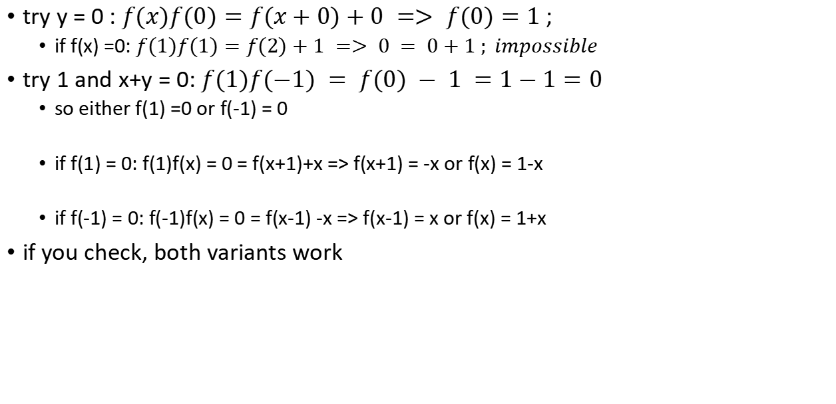
$$f(x)f(y)=f(x+y)+xy$$
try y = 0 : $f(x)f(0)=f(x+0)+0 => f(0)=1$;
if f(x) =0: $f(1)f(1)=f(2)+1 => 0 = 0+1 ; impossible$
try 1 and x+y = 0: $f(1)f(−1) = f(0) − 1 =1−1=0$
so either f(1) =0 or f(-1) = 0
if f(1) = 0: f(1)f(x) = 0 = f(x+1)+x => f(x+1) = -x or f(x) = 1-x
if f(-1) = 0: f(-1)f(x) = 0 = f(x-1) -x => f(x-1) = x or f(x) = 1+x
if you check, both variants work

Slide 19
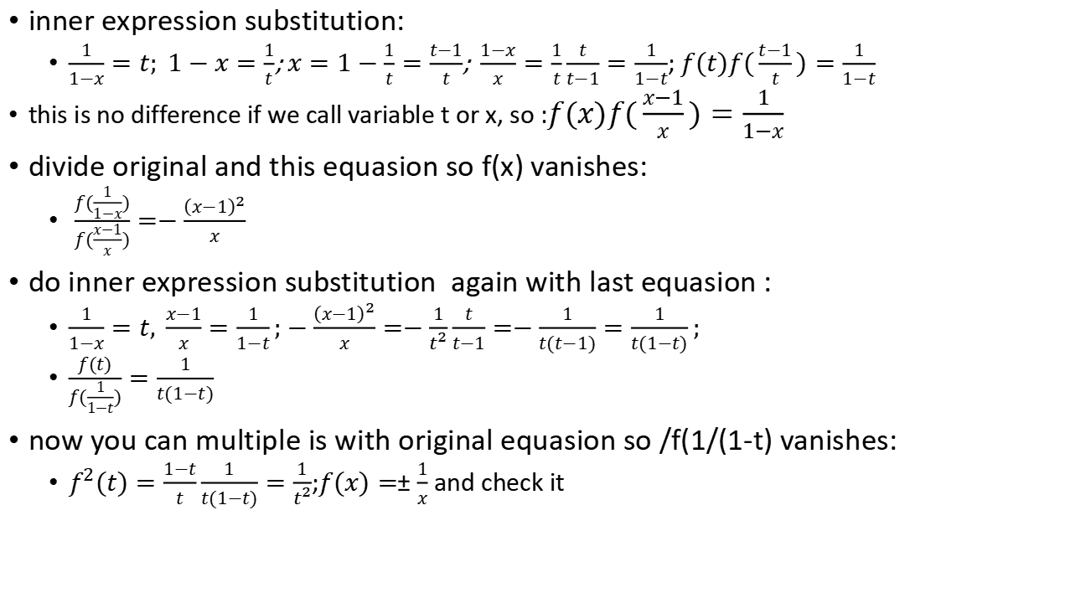

$$f(x)f(\frac{1}{1−x})=\frac{1−x}{x}$$
inner expression substitution:
$\frac{1}{1−x}=t; 1−x=\frac{1}{t}$;$x=1−\frac{1}{t}=\frac{t−1}{t}$;$\frac{1−x}{x}=\frac{1}{t}\frac{t}{t−1}=\frac{1}{1−t}$;$f(t)f(\frac{t−1}{t})=\frac{1}{1−t}$
this is no difference if we call variable t or x, so :$f(x)f(\frac{x−1}{x})=\frac{1}{1−x}$
divide original and this equasion so f(x) vanishes:
$\frac{f(\frac{1}{1−x})}{f(\frac{x−1}{x})}=−\frac{{\left(x−1\right)}^{2}}{x}$
do inner expression substitution again with last equasion :
$\frac{1}{1−x}=t, \frac{x−1}{x}=\frac{1}{1−t};−\frac{{\left(x−1\right)}^{2}}{x}=−\frac{1}{t^{2}}\frac{t}{t−1}=−\frac{1}{t(t−1)}=\frac{1}{t(1−t)};$
$\frac{f(t)}{f(\frac{1}{1−t})}=\frac{1}{t(1−t)}$
now you can multiple is with original equasion so /f(1/(1-t) vanishes:
$f^{2}(t)=\frac{1−t}{t}\frac{1}{t(1−t)}=\frac{1}{t^{2}}$;$f(x)=±\frac{1}{x}$ and check it

Slide 20

$f(x)f(\frac{1}{1−x})=\frac{1−x}{x}$, second way
substitute the right expression:
$\frac{1−x}{x}=t;t−x = tx; x=\frac{t}{t+1};1−x=\frac{1}{t+1}$
$f(\frac{t}{t+1})f(t+1)=t$ ; or
$f(\frac{t−1}{t})f(t)=t−1$
$\frac{f(\frac{1}{1−x})}{f(\frac{x−1}{x})}=\frac{1−x}{x}\frac{1}{x−1}=−\frac{1}{x}$

Slide 21
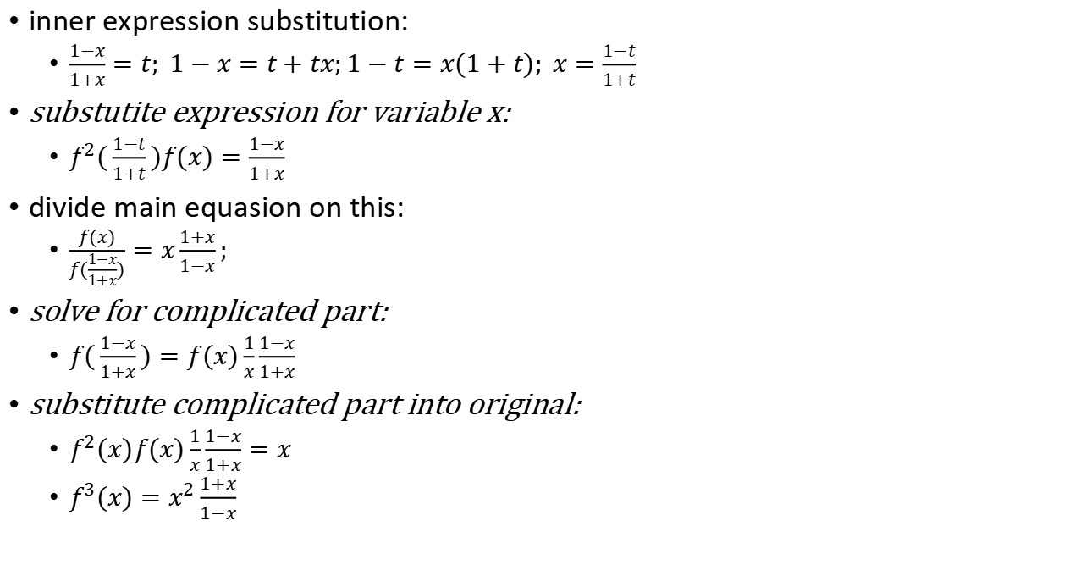

$$f^{2}(x)f(\frac{1−x}{1+x})=x$$
inner expression substitution:
$\frac{1−x}{1+x}=t; 1−x=t+tx;1−t=x(1+t); x=\frac{1−t}{1+t}$
substutite expression for variable x:
$f^{2}(\frac{1−t}{1+t})f(x)=\frac{1−x}{1+x}$
divide main equasion on this:
$\frac{f(x)}{f(\frac{1−x}{1+x})}=x\frac{1+x}{1−x};$
solve for complicated part:
$f(\frac{1−x}{1+x})=f(x)\frac{1}{x}\frac{1−x}{1+x}$
substitute complicated part into original:
$f^{2}(x)f(x)\frac{1}{x}\frac{1−x}{1+x}=x$
$f^{3}(x)=x^{2}\frac{1+x}{1−x}$

Slide 22
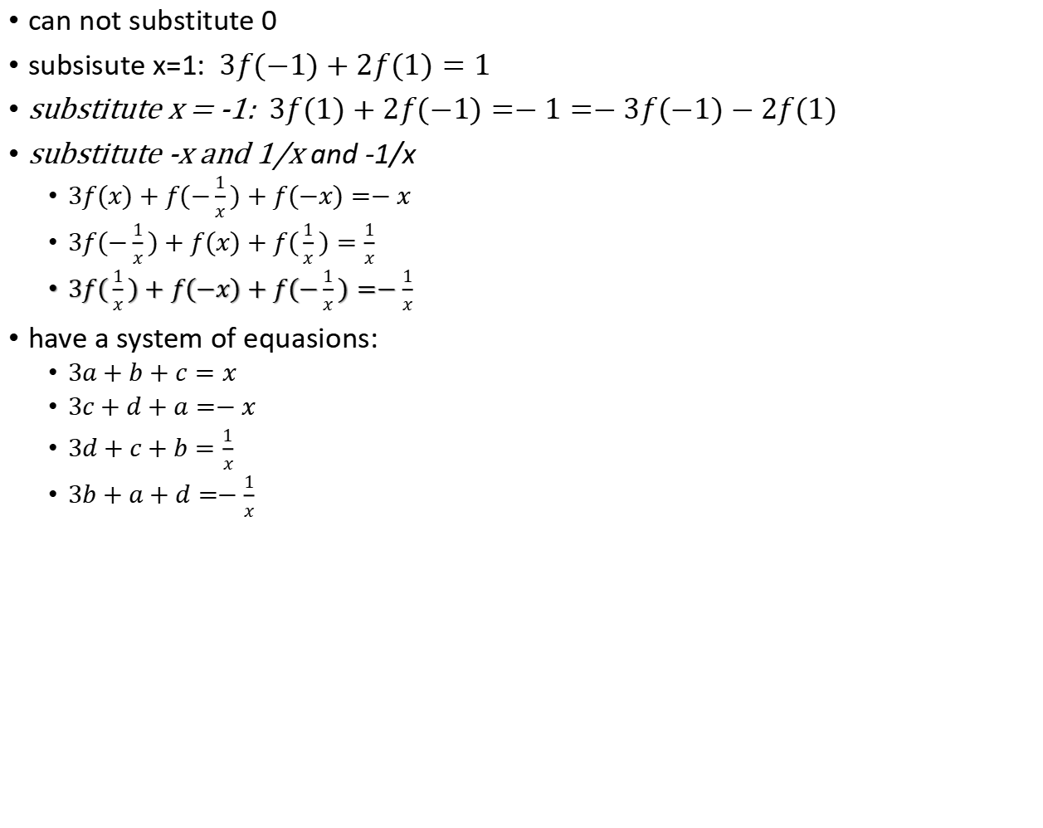

$$3f(−x)+f(\frac{1}{x})+f(x)=x$$
can not substitute 0
subsisute x=1: $3f(−1)+2f(1)=1$
substitute x = -1: $3f(1)+2f(−1)=−1=−3f(−1)−2f(1)$
substitute -x and 1/x and -1/x
$3f(x)+f(−\frac{1}{x})+f(−x)=−x$
$3f(−\frac{1}{x})+f(x)+f(\frac{1}{x})=\frac{1}{x}$
$3f(\frac{1}{x})+f(−x)+f(−\frac{1}{x})=−\frac{1}{x}$
have a system of equasions:
$3a+b+c=x$
$3c+d+a=−x$
$3d+c+b=\frac{1}{x}$
$3b+a+d=−\frac{1}{x}$

Slide 23
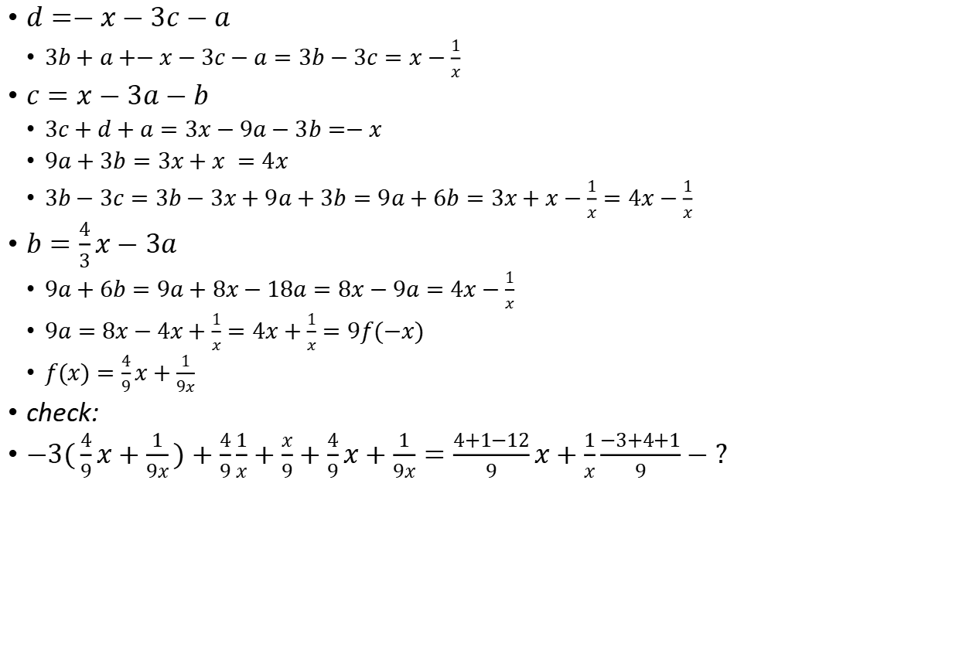

$$3f(−x)+f(\frac{1}{x})+f(x)=x − 2$$
$d=−x−3c−a$
$3b+a+−x−3c−a=3b−3c=x−\frac{1}{x}$
$c=x−3a−b$
$3c+d+a=3x−9a−3b=−x$
$9a+3b=3x+x =4x$
$3b−3c=3b−3x+9a+3b=9a+6b=3x+x−\frac{1}{x}=4x−\frac{1}{x}$
$b=\frac{4}{3}x−3a$
$9a+6b=9a+8x−18a=8x−9a=4x−\frac{1}{x}$
$9a=8x−4x+\frac{1}{x}=4x+\frac{1}{x}=9f(−x)$
$f(x)=\frac{4}{9}x+\frac{1}{9x}$
check:
$−3(\frac{4}{9}x+\frac{1}{9x})+\frac{4}{9}\frac{1}{x}+\frac{x}{9}+\frac{4}{9}x+\frac{1}{9x}=\frac{4+1−12}{9}x+\frac{1}{x}\frac{−3+4+1}{9}−?$

Slide 24
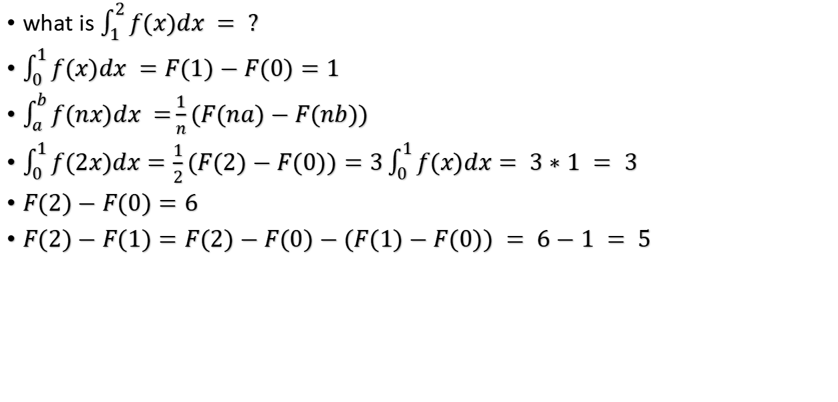
Integral functional: f(2x) = 3f(x);$\int_{0}^{1}{f(x)dx = 1}$
what is $\int_{1}^{2}{f(x)dx = ?}$
$\int_{0}^{1}{f(x)dx }=F(1)−F(0)=1$
$\int_{a}^{b}{f(nx)dx =}\frac{1}{n}(F(na)−F(nb))$
$\int_{0}^{1}{f(2x)dx}=\frac{1}{2}(F(2)−F(0))=3\int_{0}^{1}{f(x)dx}= 3∗1 = 3$
$F(2)−F(0)=6$
$F(2)−F(1)=F(2)−F(0)−(F(1)−F(0)) = 6−1 = 5$

Slide 25

Inductive loop function
$f(1) =f(2) = 1$
$f(n)=f(n−1)−f(n−2)+x; for n≥3$
x | f(x) | f(x)-x
n | n | 0
n+1 | n | -1
n+2 | n-n+n+2=n+2 | 2
n+3 | n+2-n+n+3=n+5 | 3
n+4 | n+5-n-2+n+4=n+7 | 3
n+5 | n+7-n-5+n+5=n+7 | 2
n+6 | n+7-n-7+n+6 = n+6 | 0
n+7 | n+6-n-7+n+7=n+6 | -1
n+8 | n+6-n-6+n+8 | 0
... | ... | ...
there is a loop:
f(x)= {x,x-1,x,x+2,x+3,x+2}
for each 1..6 values,
means {x,x-1,x,x+2,x+3,x+2}[(n-1) mod 6]
so
f(2018): {2017 mod 6} = 1 mod 6, f(2018) = x-1= 2018-1 = 2017
f(2022) = {2021 mod 6} =5 mod 6
f(2022)= x+2 = 2022+2 = 2024

Slide 26
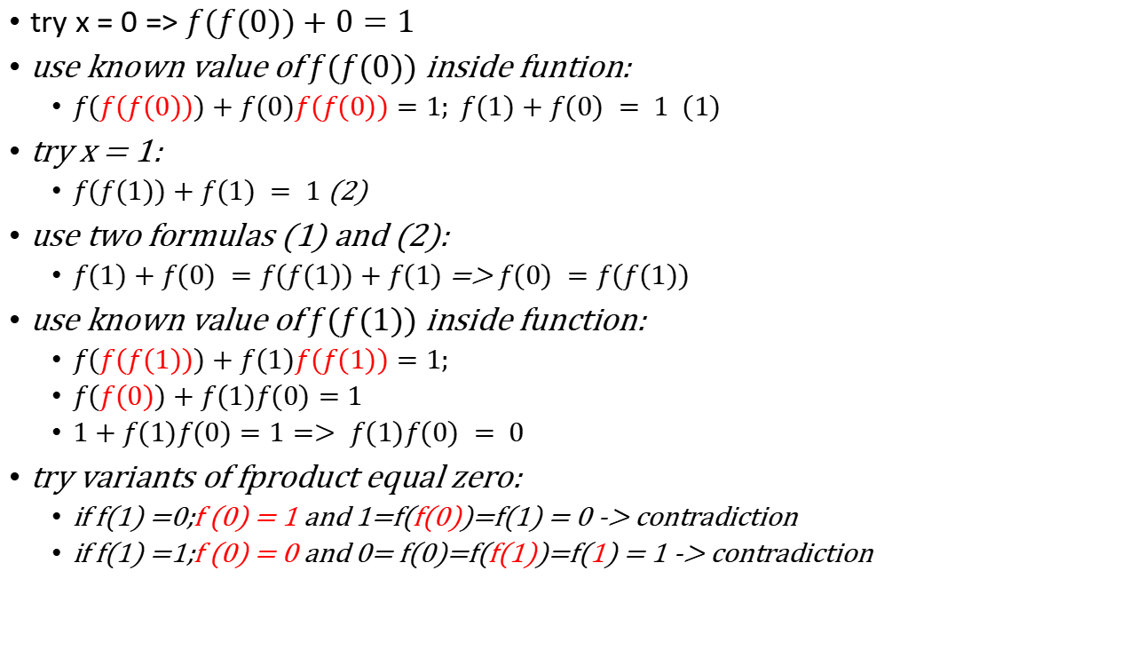
$$f(f(x))+xf(x)=1; x∈ℝ$$
try x = 0 => $f(f(0))+0=1$
use known value of $f(f(0))$ inside funtion:
$f(f(f(0)))+f(0)f(f(0))=1; f(1)+f(0) = 1 (1)$
try x = 1:
$f(f(1))+f(1) = 1$(2)
use two formulas (1) and (2):
$f(1)+f(0) =f(f(1))+f(1)$ => $f(0) =f(f(1))$
use known value of $f(f(1))$ inside function:
$f(f(f(1)))+f(1)f(f(1))=1;$
$f(f(0))+f(1)f(0)=1$
$1+f(1)f(0)=1=> f(1)f(0) = 0$
try variants of fproduct equal zero:
if f(1) =0;f (0) = 1 and 1=f(f(0))=f(1) = 0 -> contradiction
if f(1) =1;f (0) = 0 and 0= f(0)=f(f(1))=f(1) = 1 -> contradiction

Slide 27
f(2a) + 2f(b) = f(f(a+b))
try a =0: f(0) + 2f(a) = f(f(a))
try both zeros: f(0) + 2f(0) = f(f(0))= 3f(0)
try b = 0: f(2a) + 2f(0) = f(f(a))
try to equalize terms inside:
f(2x) + 2f(2x) = f(f(3x))= 3f(2x)
use two equasions:
f(0) + 2f(a) = f(2a) + 2f(0)
f(2a) =2f(a)- f(0)
use x and -x as vairbales:
f(-2x) + 2f(x) =f(f(0))=f(2x) + 2f(-x)
2(f(x) - f(-x) ) = f(2x) -f(-2x)
answer: f(x) = 2x+n

Slide 28
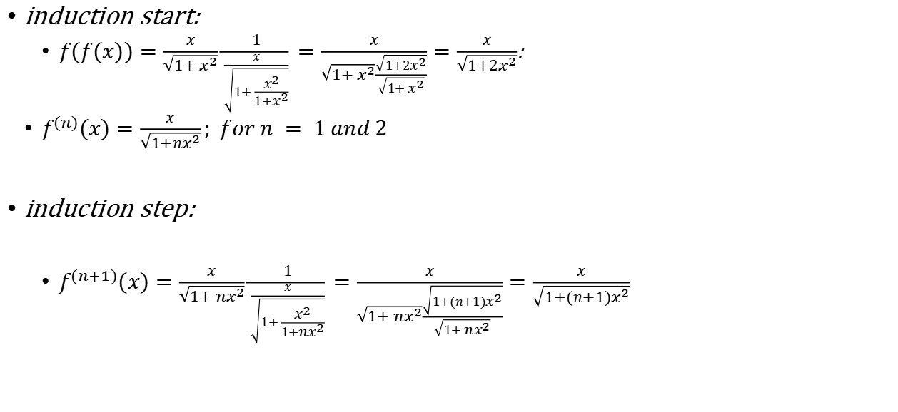

$$f(x)=\frac{x}{\sqrt{1+x^{2}}};f^{(n)}(x) − ?$$
induction start:
$f(f(x))=\frac{x}{\sqrt{1+x^{2}}}\frac{1}{\frac{x}{\sqrt{1+\frac{x^{2}}{1+x^{2}}}}}=\frac{x}{\sqrt{1+x^{2}}\frac{\sqrt{1+2x^{2}}}{\sqrt{1+x^{2}}}}=\frac{x}{\sqrt{1+2x^{2}}}$:
$f^{(n)}(x)=\frac{x}{\sqrt{1+nx^{2}}}; for n = 1 and 2$
induction step:
$f^{(n+1)}(x)=\frac{x}{\sqrt{1+{nx}^{2}}}\frac{1}{\frac{x}{\sqrt{1+\frac{x^{2}}{1+{nx}^{2}}}}}=\frac{x}{\sqrt{1+{nx}^{2}}\frac{\sqrt{1+(n+1)x^{2}}}{\sqrt{1+{nx}^{2}}}}=\frac{x}{\sqrt{1+(n+1)x^{2}}}$

Slide 29


$$f(\frac{x−3}{x+1})+f(\frac{3+x}{1−x})=x$$
$\frac{x−3}{x+1}=t;$
$x−3=tx+t ;x(1−t)=3+t$
$x=\frac{3+t}{1−t}$
$\frac{3+x}{1−x}=\frac{3+\frac{3+t}{1−t}}{1−\frac{3+t}{1−t}}=\frac{3−3t+3+t}{1−t−3−t}=\frac{6−2t}{−2−2t}=\frac{t−3}{1+t}$
$f(t)+f(\frac{t−3}{1+t})=\frac{3+t}{1−t}$
$\frac{3+x}{1−x}=t$
$x+3=−tx+t ;x(1+t)=t−3$
$x=\frac{t−3}{t+1}$
$\frac{x−3}{x+1}=\frac{\frac{t−3}{t+1}−3}{\frac{t−3}{t+1}+1}=\frac{t−3−3t−3}{t−3+t+1}=\frac{−2t−6}{2t−2}=\frac{t+3}{1−t}$
$f(\frac{t+3}{1−t})+f(t)=\frac{t−3}{t+1}$

Slide 30
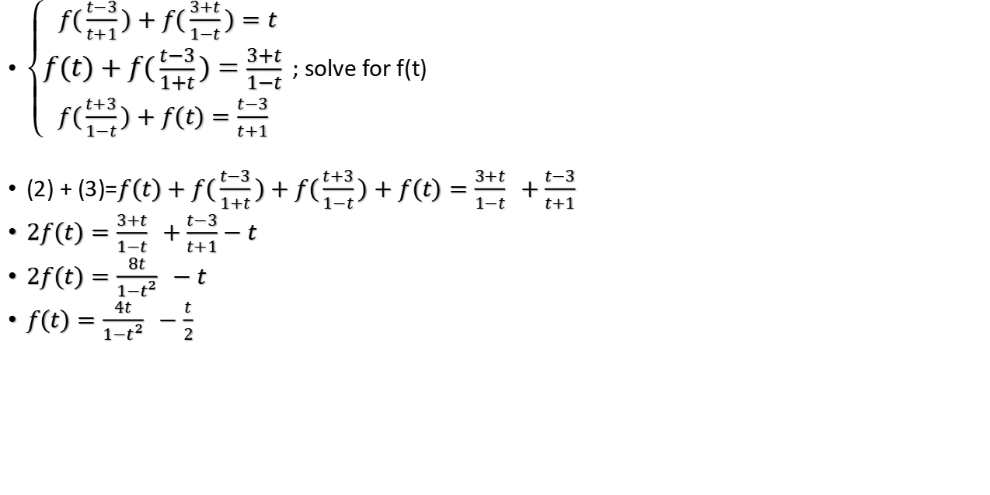
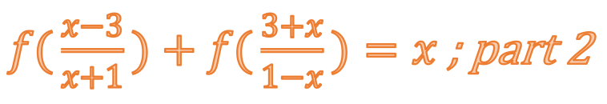
$f(\frac{x−3}{x+1})+f(\frac{3+x}{1−x})=x$ ; part 2
$\left\{\begin{matrix}f(\frac{t−3}{t+1})+f(\frac{3+t}{1−t})=t \\ f(t)+f(\frac{t−3}{1+t})=\frac{3+t}{1−t} \\ f(\frac{t+3}{1−t})+f(t)=\frac{t−3}{t+1} \end{matrix}\right.$; solve for f(t)
(2) + (3)=$f(t)+f(\frac{t−3}{1+t})+f(\frac{t+3}{1−t})+f(t)=\frac{3+t}{1−t} +\frac{t−3}{t+1}$
$2f(t)=\frac{3+t}{1−t} +\frac{t−3}{t+1}−t$
$2f(t)=\frac{8t}{1−t^{2}} −t$
$f(t)=\frac{4t}{1−t^{2}} −\frac{t}{2}$

Slide 31

$$f(x)−f(1−x)=x$$
$x=0:f(0)−f(1)=0$
$x=1:f(1)−f(0)=1$
$f(0)=f(1) and f(1)=f(0)+1−>impossible$

Slide 32


$$f(\frac{x}{f(y)})=\frac{x}{y}$$
$substitute 0 :$
$x=0 →f(0)=0$
$substitute constant function value:$
$f(1)=f(\frac{f(y)}{f(y)})=\frac{f(y)}{y};$
$f(y)=yf(1)) Cy$
$f(\frac{x}{f(y)})=\frac{Cx}{Cy}=\frac{x}{y}$

Slide 33
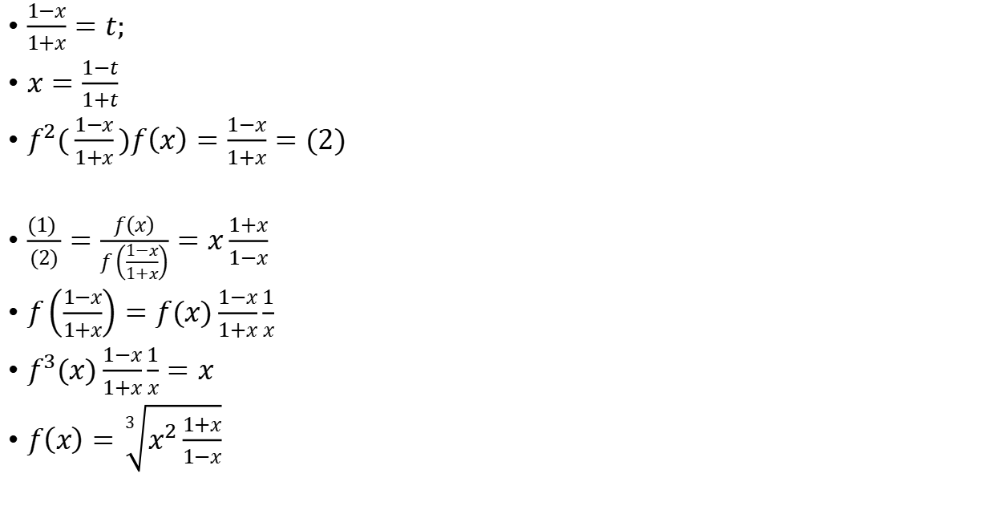

$$f^{2}(x)f\left(\frac{1−x}{1+x}\right)=x=(1)$$
$\frac{1−x}{1+x}=t;$
$x=\frac{1−t}{1+t}$
$f^{2}(\frac{1−x}{1+x})f\left(x\right)=\frac{1−x}{1+x}=(2)$
$\frac{(1) }{(2)}=\frac{f\left(x\right)}{f\left(\frac{1−x}{1+x}\right)}=x\frac{1+x}{1−x}$
$f\left(\frac{1−x}{1+x}\right)=f(x)\frac{1−x}{1+x}\frac{1}{x}$
$f^{3}(x)\frac{1−x}{1+x}\frac{1}{x}=x$
$f\left(x\right)=\sqrt[3]{x^{2}\frac{1+x}{1−x}}$

Slide 34
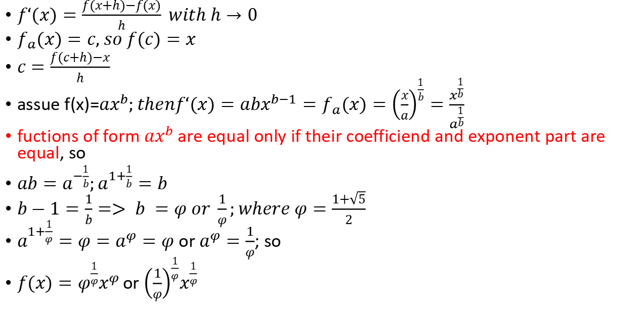
Derivative equals inverse: $f‘(x)=f_{a}(x)$
$f‘(x)=\frac{f(x+h)−f(x)}{h} with h→0$
$f_{a}(x)=c, so f(c)=x$
$c=\frac{f(c+h)−x}{h}$
assue f(x)=$ax^{b};thenf‘(x)=abx^{b−1}=f_{a}(x)={\left(\frac{x}{a}\right)}^{\frac{1}{b}}=\frac{x^{\frac{1}{b}}}{a^{\frac{1}{b}}}$
fuctions of form $ax^{b}$ are equal only if their coefficiend and exponent part are equal, so
$ab=a^{−\frac{1}{b}};a^{1+\frac{1}{b}}=b$
$b−1=\frac{1}{b}=> b =φ or \frac{1}{φ};where φ=\frac{1+\sqrt{5}}{2}$
$a^{1+\frac{1}{φ}}=φ=a^{φ}=φ$ or $a^{φ}=\frac{1}{φ}$; so
$f(x)=φ^{\frac{1}{φ}}x^{φ }$or ${\left(\frac{1}{φ}\right)}^{\frac{1}{φ}}x^{\frac{1}{φ} }$

Slide 35
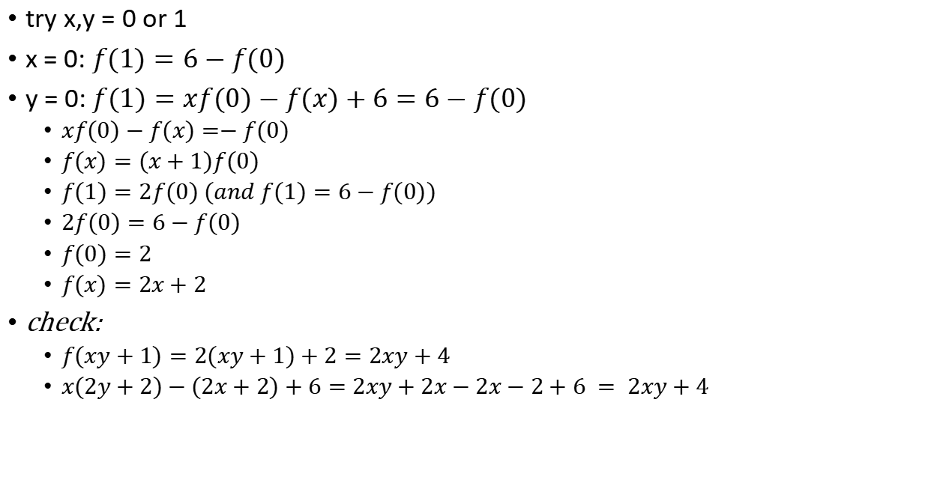
$$f(xy+1)=xf(y)−f(x)+6$$
try x,y = 0 or 1
x = 0: $f(1)=6−f(0)$
y = 0: $f(1)=xf(0)−f(x)+6=6−f(0)$
$xf(0)−f(x)=−f(0)$
$f(x)=(x+1)f(0)$
$f(1)=2f(0) (and f(1)=6−f(0))$
$2f(0)=6−f(0)$
$f(0)=2$
$f(x)=2x+2$
check:
$f(xy+1)=2(xy+1)+2=2xy+4$
$x(2y+2)−(2x+2)+6=2xy+2x−2x−2+6 = 2xy+4$

Slide 36
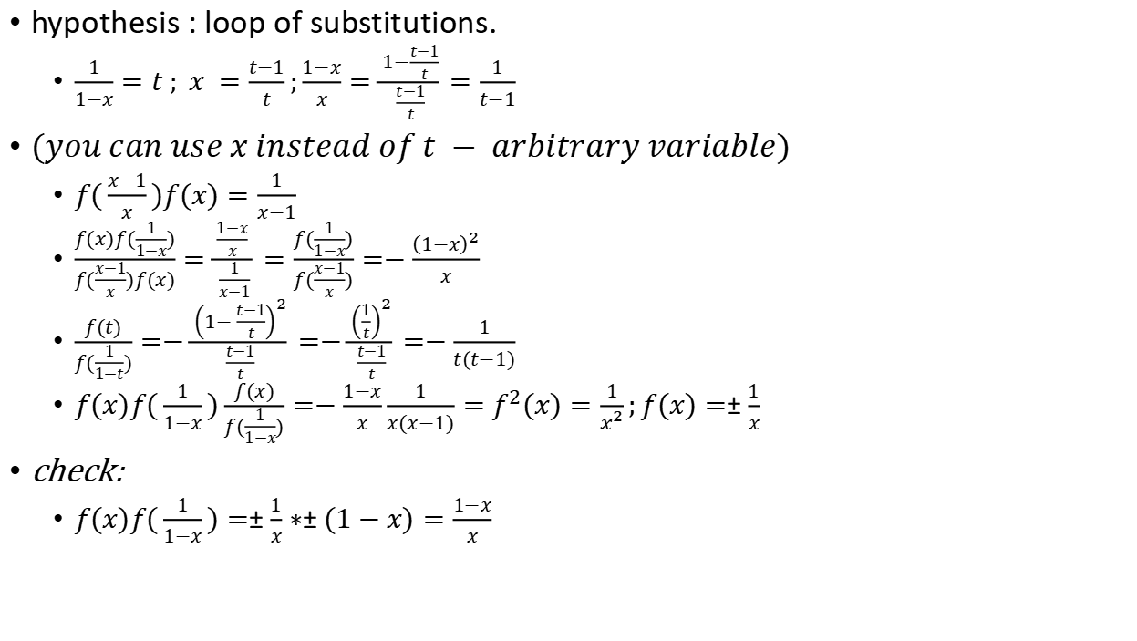

$$f(x)f(\frac{1}{1−x})=\frac{1−x}{x}$$
hypothesis : loop of substitutions.
$\frac{1}{1−x}=t ; x =\frac{t−1}{t};\frac{1−x}{x}=\frac{1−\frac{t−1}{t}}{\frac{t−1}{t}}=\frac{1}{t−1}$
$(you can use x instead of t − arbitrary variable)$
$f(\frac{x−1}{x})f(x)=\frac{1}{x−1}$
$\frac{f(x)f(\frac{1}{1−x})}{f(\frac{x−1}{x})f(x)}=\frac{\frac{1−x}{x} }{\frac{1}{x−1}}=\frac{f(\frac{1}{1−x})}{f(\frac{x−1}{x})}=−\frac{{\left(1−x\right)}^{2}}{x}$
$\frac{f(t)}{f(\frac{1}{1−t})}=−\frac{{\left(1−\frac{t−1}{t}\right)}^{2}}{\frac{t−1}{t}}=−\frac{{\left(\frac{1}{t}\right)}^{2}}{\frac{t−1}{t}}=−\frac{1}{t(t−1)}$
$f(x)f(\frac{1}{1−x})\frac{f(x)}{f(\frac{1}{1−x})}=−\frac{1−x}{x}\frac{1}{x(x−1)}=f^{2}(x)=\frac{1}{x^{2}};f(x)=±\frac{1}{x}$
check:
$f(x)f(\frac{1}{1−x})=±\frac{1}{x}∗±(1−x)=\frac{1−x}{x}$

Slide 37
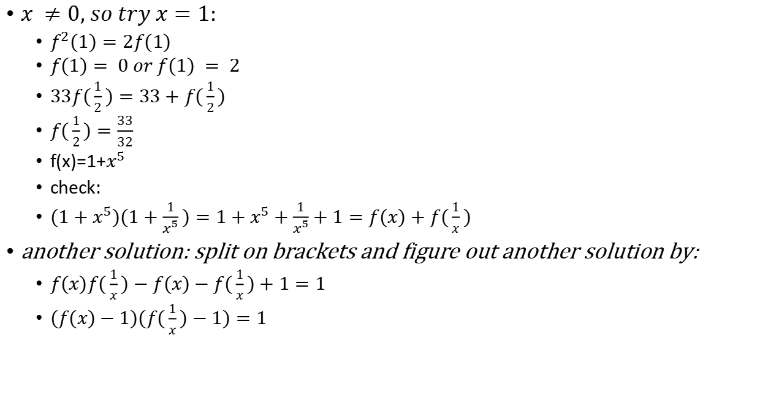
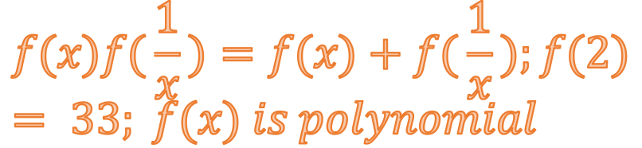
$$f(x)f(\frac{1}{x})=f(x)+f(\frac{1}{x});f(2)= 33; f(x) is polynomial$$
$x ≠0, so try x=1:$
$f^{2}(1)=2f(1)$
$f(1)= 0 or f(1) = 2$
$33f(\frac{1}{2})=33+f(\frac{1}{2})$
$f(\frac{1}{2})=\frac{33}{32}$
f(x)=1+$x^{5}$
check:
$(1+x^{5})(1+\frac{1}{x^{5}})=1+x^{5}+\frac{1}{x^{5}}+1=f(x)+f(\frac{1}{x})$
another solution: split on brackets and figure out another solution by:
$f(x)f(\frac{1}{x})−f(x)−f(\frac{1}{x})+1=1$
$(f(x)−1)(f(\frac{1}{x})−1)=1$

Slide 38
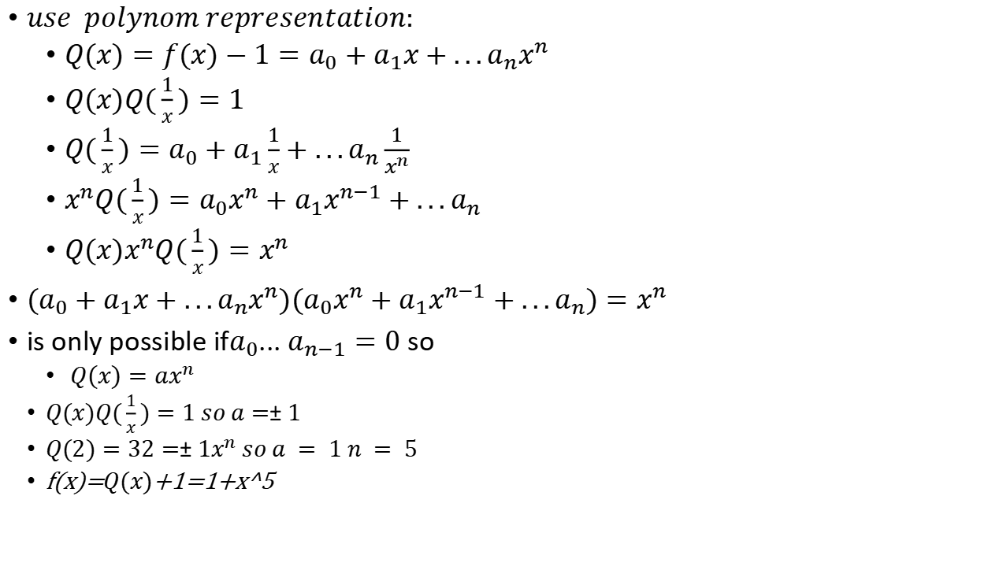
$use polynom representation:$
$Q(x)=f(x)−1=a_{0}+a_{1}x+...a_{n}x^{n}$
$Q(x)Q(\frac{1}{x})=1$
$Q(\frac{1}{x})=a_{0}+a_{1}\frac{1}{x}+...a_{n}\frac{1}{x^{n}}$
$x^{n}Q(\frac{1}{x})=a_{0}x^{n}+a_{1}x^{n−1}+...a_{n}$
$Q(x)x^{n}Q(\frac{1}{x})=x^{n}$
$(a_{0}+a_{1}x+...a_{n}x^{n})(a_{0}x^{n}+a_{1}x^{n−1}+...a_{n})=x^{n}$
is only possible if$a_{0}$... $a_{n−1}=0$ so
$Q(x)=ax^{n}$
$Q(x)Q(\frac{1}{x})=1 so a=±1$
$Q(2)=32=±1x^{n} so a = 1 n = 5$
f(x)=$Q(x)$+1=1+x^5

Slide 39
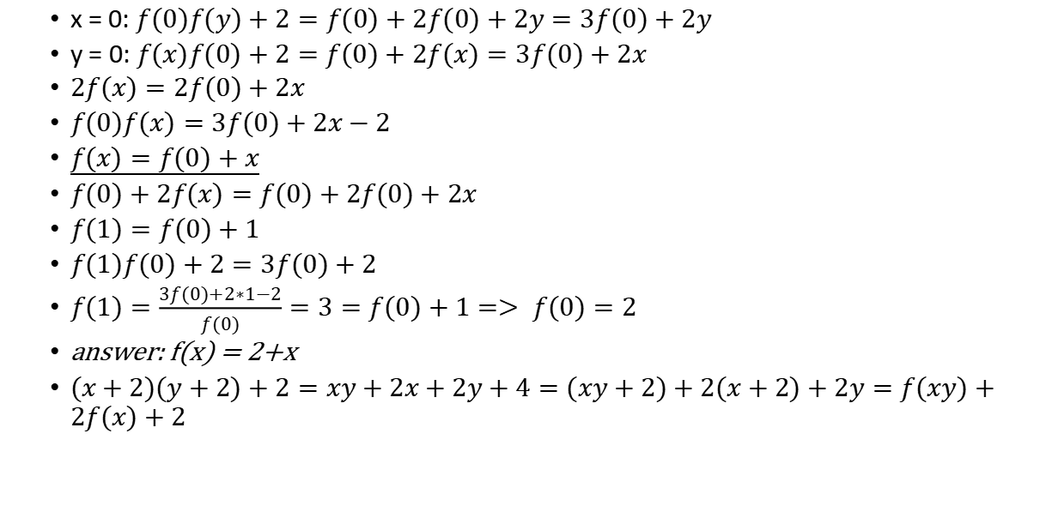
$$f(x)f(y)+2=f(xy)+2f(x)+2y$$
x = 0: $f(0)f(y)+2=f(0)+2f(0)+2y=3f(0)+2y$
y = 0: $f(x)f(0)+2=f(0)+2f(x)=3f(0)+2x$
$2f(x)=2f(0)+2x$
$f(0)f(x)=3f(0)+2x−2$
$f(x)=f(0)+x$
$f(0)+2f(x)=f(0)+2f(0)+2x$
$f(1)=f(0)+1$
$f(1)f(0)+2=3f(0)+2$
$f(1)=\frac{3f(0)+2∗1−2}{f(0)}=3=f(0)+1=> f(0)=2$
answer: f(x) = 2+x
$(x+2)(y+2)+2=xy+2x+2y+4=(xy+2)+2(x+2)+2y=f(xy)+2f(x)+2$

Slide 40


$$f(2x)f(x+\frac{1}{2})=f(x)$$
$try x=\frac{1}{2};f^{2}(1)=f(\frac{1}{2})$
$try x=0;f(0)f(\frac{1}{2})=f(0)$
$f(0)= 0 or f(\frac{1}{2})= 1$
if $f(0)= 0$:
$f(−1)f(0)=f(−\frac{1}{2}) :=f(−\frac{1}{2}) = 0$
finish - ?

Slide 41
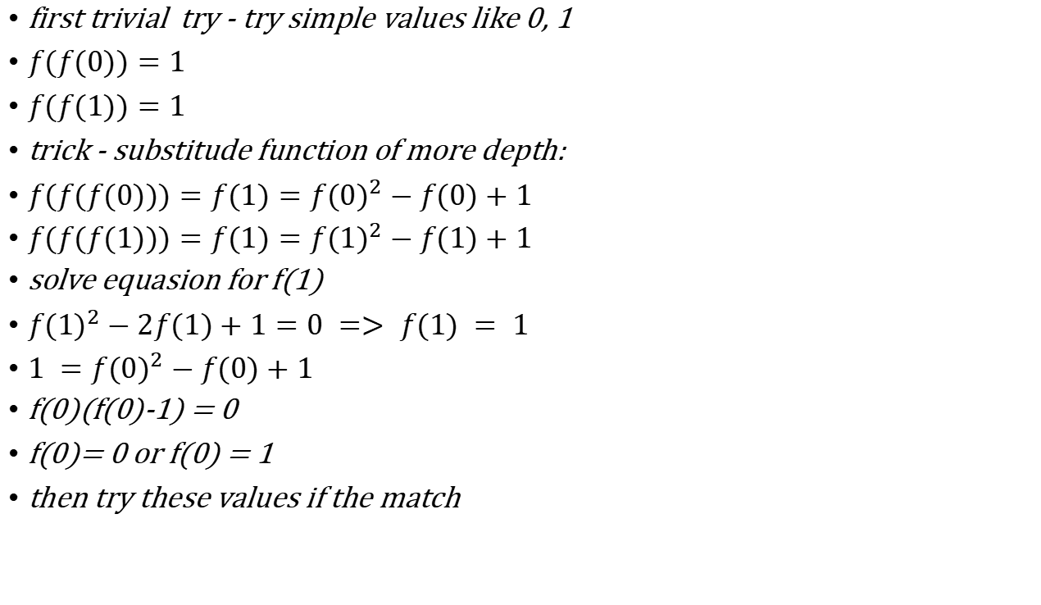
$$f(f(x))=x^{2}−x+1; f(0)−?$$
first trivial try - try simple values like 0, 1
$f(f(0))=1$
$f(f(1))=1$
trick - substitude function of more depth:
$f(f(f(0)))=f(1)={f(0)}^{2}−f(0)+1$
$f(f(f(1)))=f(1)={f(1)}^{2}−f(1)+1$
solve equasion for f(1)
${f(1)}^{2}−2f(1)+1=0 => f(1) = 1$
$1 ={f(0)}^{2}−f(0)+1$
f(0)(f(0)-1) = 0
f(0)= 0 or f(0) = 1
then try these values if the match

Slide 42

$$f(x)=f(−x)3^{x}$$
$f(x){\sqrt{3}}^{−x}=f(−x){\sqrt{3}}^{x}$
$\frac{f(x)}{f(−x)}=\frac{{\sqrt{3}}^{x}}{{\sqrt{3}}^{−x}}=\frac{g(x){\sqrt{3}}^{x}}{{g(−x)\sqrt{3}}^{−x}}=> f(x) =g(x){\sqrt{3}}^{x}$
$where g(x) is even non−zero function : g(x) = g(−x)$

Slide 43
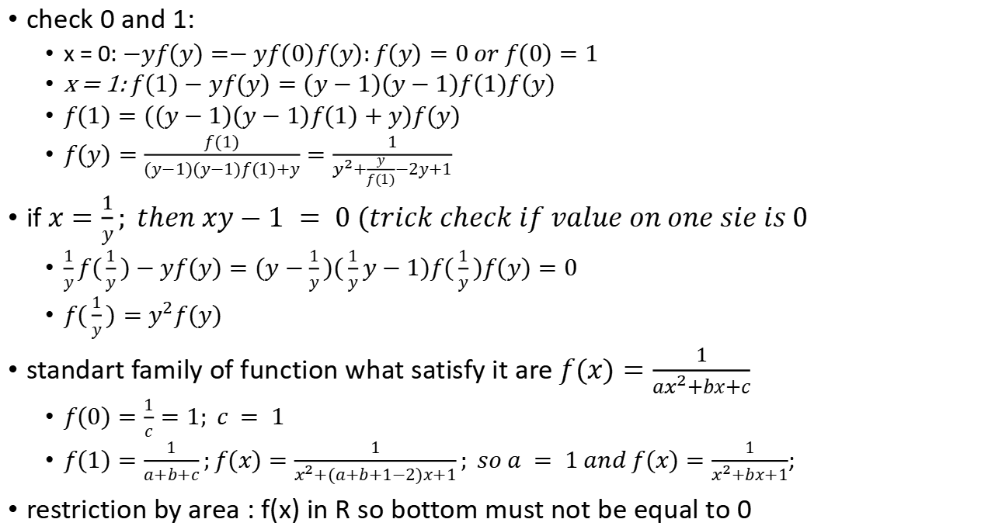
$$xf(x)−yf(y)=(y−x)(xy−1)f(x)f(y)$$
check 0 and 1:
x = 0: $−yf(y)=−yf(0)f(y):f(y)=0 or f(0)=1$
x = 1: $f(1)−yf(y)=(y−1)(y−1)f(1)f(y)$
$f(1)=((y−1)(y−1)f(1)+y)f(y)$
$f(y)=\frac{f(1)}{(y−1)(y−1)f(1)+y}=\frac{1}{y^{2}+\frac{y}{f(1)}−2y+1}$
if $x=\frac{1}{y}; then xy−1 = 0 (trick check if value on one sie is 0$
$\frac{1}{y}f(\frac{1}{y})−yf(y)=(y−\frac{1}{y})(\frac{1}{y}y−1)f(\frac{1}{y})f(y)=0$
$f(\frac{1}{y})=y^{2}f(y)$
standart family of function what satisfy it are $f(x)=\frac{1}{ax^{2}+bx+c}$
$f(0)=\frac{1}{c}=1; c = 1$
$f(1)=\frac{1}{a+b+c};f(x)=\frac{1}{x^{2}+(a+b+1−2)x+1}; so a = 1 and f(x)=\frac{1}{x^{2}+bx+1}$;
restriction by area : f(x) in R so bottom must not be equal to 0

